Slide 1
Forecasting and Planning
Terrell A. Turner, CPA

Slide 2

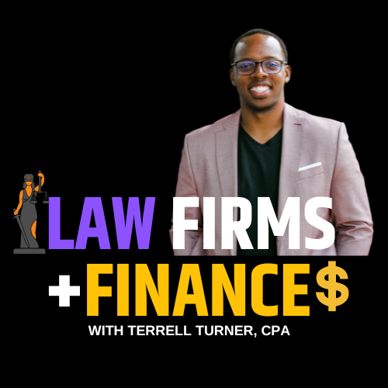


Terrell A. Turner, CPA
CEO, TLTurner Group
  Training for law firm admins
  Data Analytics for law firms
  Bookkeeping & CFO support
  Law Firm Finance Chair – ABA
  www.TLTurnerGroup.com​

Slide 3

Learning Objectives
Understand the Fundamentals of Forecasting
Differentiate Between Budgeting and Forecasting Methods
Apply Best Practices to Build and Maintain Effective Forecasts

Slide 4





Legal Administrator Responsibilities
CORPORATE
HUMAN
RESOURCES
OPERATIONS
BUSINESS
PARTNERS
FINANCE
IT
Notes:
When you are new to legal administration there is a lot for you to remember and keep in mind, in some ways you play a role in all of these key areas and the only way for your to figure

Slide 5
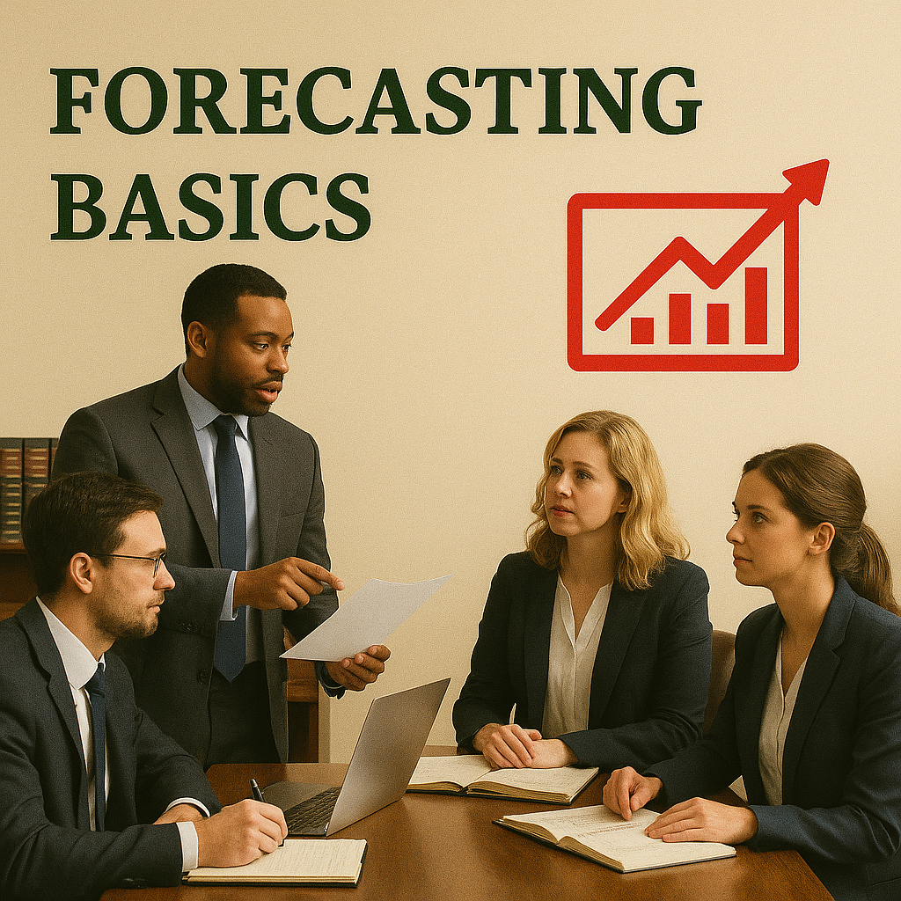
Forecasting Basics
100% accuracy isn’t real
Directional guidance in critical
Build off of KPI’s and drivers
Frequency of updates are debatable
History is not guaranteed to repeat but it is highly likely
Notes:
Financial statements -

Slide 6
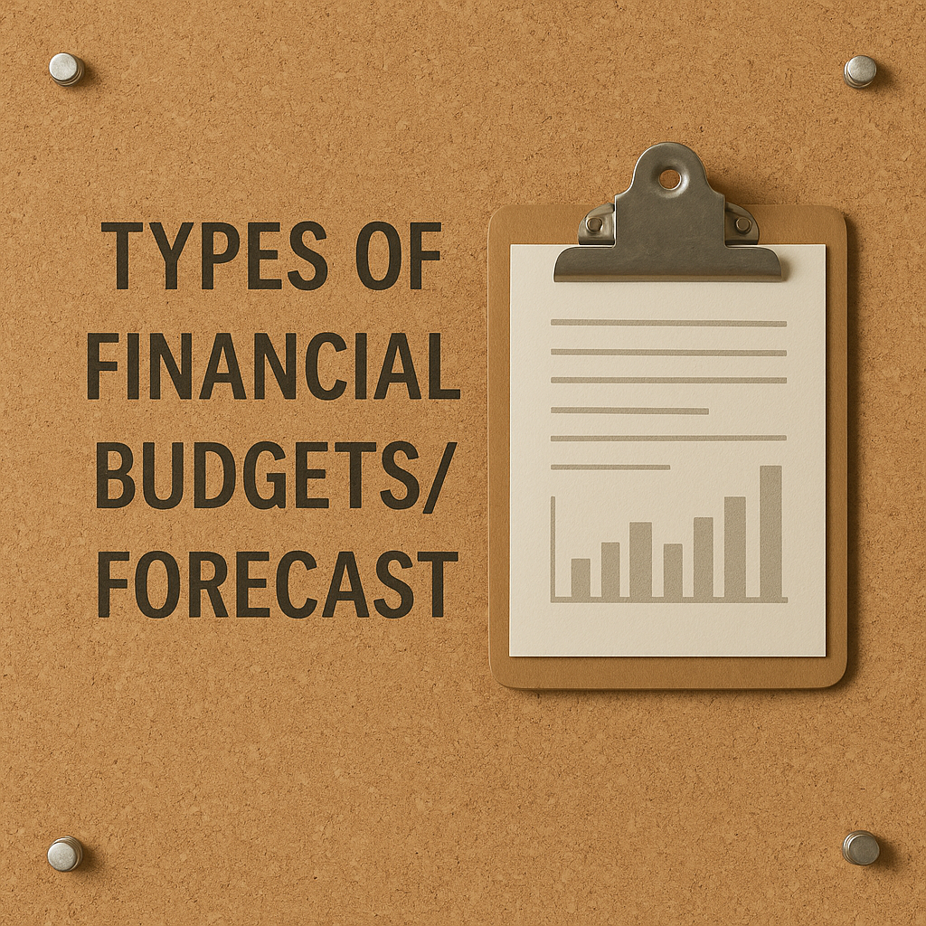
Types of Financial Budgets/Forecast
Benchmark budgeting
  Easiest to create
  Not the most accurate
Bottoms up forecast
  Detailed model
  Based on historical trends
Scenario planning
  Based on key drivers
  Flexible modeling option
  Most complex to develop
Generated with ChatGPT-Dalle

Slide 7
Use Case Examples
Benchmark Budget
Bottoms Up Forecast
Scenario Planning

Slide 8
Live Demonstration
Benchmark Budget
Bottoms Up Forecast
Scenario Planning

Slide 9

Best Practices
Review your forecast assumptions routinely
Make forecast updates when major factors change
Track financial data and KPI’s consistently
Consider the decision making process
Compare projected vs. actual results and ask others to contribute to explaining the variances
Generated with ChatGPT-Dalle
Notes:
Consider the decision making process - a forecast should be aligned with the way the firm makes decisions, for example if the firm makes decision in a conservative manner forecast that way

Slide 10

How Do You Build a Budget
Start with a decision
Identify drivers
Review historical data
Test assumptions
Review your results and make adjustments
Notes:
Financial statements -

Slide 11
Questions

Slide 12





Let's Connect!
Terrell A. Turner, CPA​
Law Firm + Finance
www.tlturnergroup.com​
terrell@tlturnergroup.com​

