Slide 1

A Framework for Leading Law Firms with Confidence
ALA Executive Leadership
Terrell A. Turner, CPA

Slide 2

Agenda:
Define the right KPIs for your firm
Describe the key drivers that move your KPIs
Identify the common roadblocks & blind spots
Discuss practical tips and strategies for future success

Slide 3





Terrell A. Turner, CPA
CEO, TLTurner Group
  Training for law firm admins
  Data Analytics for law firms
  Bookkeeping & CFO support
  Law Firm Finance Chair – ABA
  www.TLTurnerGroup.com​

Slide 4

How I Came to Learn What I’m Sharing
A client reached out to us for data analytics because they wanted to grow.
After digging into the details, I had two things to tell them...

Slide 5

Why pay attention to KPI’s

Slide 6


Common KPI’s

Slide 7

KPI framework
The Steps to KPI Success
Define your goal
Clarify your milestones
Understand your drivers
Determine your case need
Determine your staffing need
Conduct regular reviews

Slide 8






SUCCESS CAN LOOK LIKE :
Serving underserved communities
# of cases won
Size of your Revenue/Profits
The # of associates & staff
High quality customer service
Public Recognition

Slide 9
Golden Financial Formula I
Cost of your firm
Revenue Target
Desired Profits

Slide 10

Revenue Target Breakdown
Revenue
  Case Type
  Staff member
  Geography
  Fee Structure
# of Cases
  Case type
  Fee Structure

Slide 11
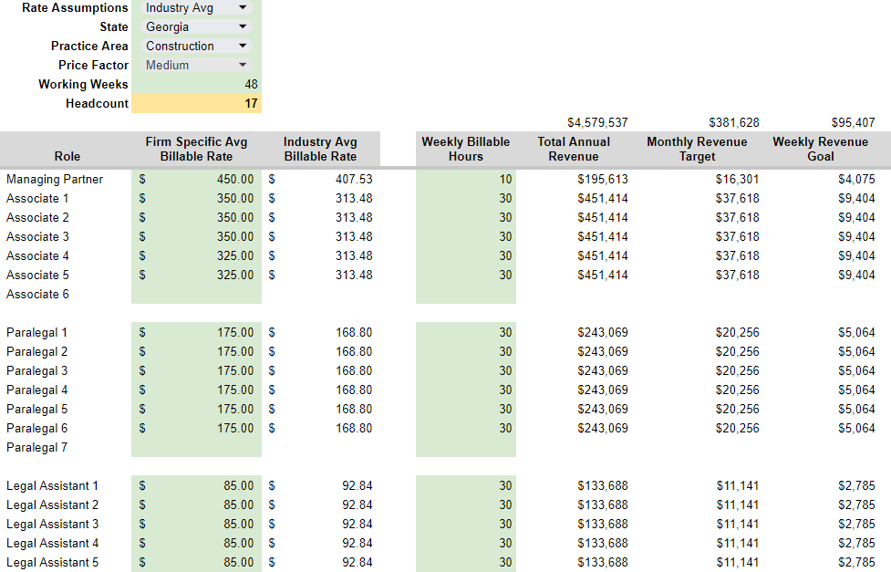
Create Milestones

Slide 12
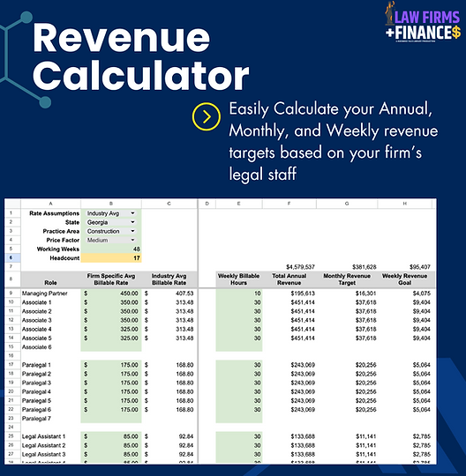

Free Revenue Calculator

Slide 13
Golden Financial Formula II
Target Revenue
Target # of Clients
Avg Case Value $$

Slide 14
Golden Financial Formula II
Target Revenue
Target # of Clients
Avg Case Value $$

Slide 15
Average Case Value
Case Type | # of Cases Closed | Value of Closed Cases | Average Case Value
Adoption | 47 | $239,136 | $5,088
Grandparents Rights | 55 | $757,900 | $13,780
Child Custody | 72 | $1,040,400 | $14,450
Divorce | 84 | $1,885,800 | $22.450
Modifications | 115 | $626,174 | $5,445
Total | 373 | $4,549,408 | $12,197

Slide 16
Golden Financial Formula II
$4.57M
375
$12,197

Slide 17
KPI framework
The Steps to KPI Success
Define your goal
Clarify your milestones
Understand your drivers
Determine your case need
Determine your staffing need
Conduct regular reviews

Slide 18
Golden Financial Formula III
Target # of Clients
Target Legal Hours
Avg Time Per Case

Slide 19
Average Case Time
Case Type | # of Cases Closed | Time spent on Closed Cases | Average Case Time Hrs
Adoption | 47 | 1,053.46 | 22.41
Grandparents Rights | 55 | 3,118.93 | 56.71
Child Custody | 72 | 4,465.24 | 62.02
Divorce | 84 | 8,381.33 | 99.78
Modifications | 115 | 2,996.05 | 26.05
Total | 373 | 20,015 | 53.66

Slide 20
Golden Financial Formula III
375 Case
20,148 hrs
53.66 hrs/case

Slide 21
Legal Staff Capacity
Case Type | # of Cases Closed | Legal Hrs Year | Average Case Time Hrs | Est. Hours Needed
Partners | 1 | 480 | 480
Associates | 5 | 1,440 | 7,200
Paralegals | 6 | 1,440 | 8,640
Legal Assistants | 3 | 1,440 | 4,320
Total | 15 |  | 20,640 | 20,148

Slide 22
Free Revenue Calculator

Slide 23

Managing the Big Picture
# of Cases
Case Value
Staff Performance
Legal Work Capacity
Revenue Produced

Slide 24

The KPI’s We’ve Covered
Revenue
Avg Case Value ($$)
Target # of Cases
Avg Time on Case (Hr)
Avg Billable Hr

Slide 25
Firm KPI Reporting & Reviews
Firm KPI | YTD Oct (Actual) | YTD Oct (Budget) | Variance
Revenue
Cases Opened
Cases Worked
Cases Closed
Avg Case Value ($$)
Avg Billable Time on Cases

Slide 26
Staff KPI Reporting & Reviews
Staff KPI | YTD Oct (Actual) | YTD Oct (Budget) | Variance
Total Billable Hours | 105 | 120 | (15)
Total Revenue | $47,250 | $54,000 | ($6,750)
Cases Opened* | - | - | -
Cases Worked | 15 | 17 | (2)
Avg Value ($$) per case | $3,150 | $3,176 | ($26)
Avg Billable Time on Case | 7.00 | 7.05 | (0.05)
Collection Rate** | 81% | 90% | (9%)

Slide 27
Agenda Recap:
Define the right KPIs for your firm
Describe the key drivers that move your KPIs
Identify the common roadblocks & blind spots
Discuss practical tips and strategies for future success

Slide 28
Recap Framework
The Steps to KPI Success
Define your goal
Clarify your milestones
Understand your drivers
Determine your case need
Determine your staffing need
Conduct regular reviews

Slide 29



Thank You for your feedback!

